Slide 1
Gender classification comparison
06 – 13 – 2022

Slide 2
1. Gender filters in CRS
Gender marker
Purpose codes (15170 – 15180)
Channel code (41146 UN Women)
SDG 5 – Gender equality
Text detection of project titles with gender keywords

Slide 3
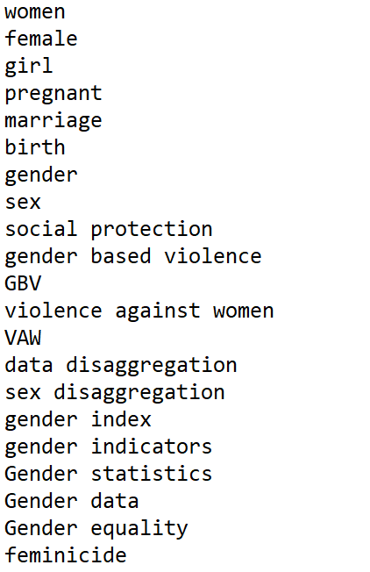
2. Text detection
Search of gender keywords in cleaned titles
e.g. “Availability of Reproductive Health Information and Services”
reproductive -> detected as gender project

Slide 4
2. How does the method work?
Predictions
not correct
Learning set
correct
Machine learning
text_id descript. gender_filter
text_id descript. gender_filter probab.
Gender is the… TRUE
Water supply…. FALSE
Women’s rights… TRUE
Small carrots…. FALSE
:
:
55222 Sexual repro… FALSE 0.962
55234 Farmer supp… FALSE 0.678
55332 Elephants in… NA 0.221
55122 Women are…. FALSE 0.983
:
:
word frequency
statistical learning
relative importance

Slide 5
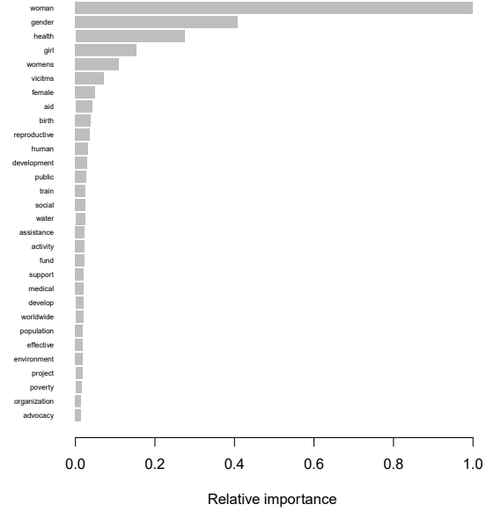
2. How does the method work?
Similar to classification by a human, algorithm assigns higher importance to words that are more frequent in marked gender projects

Slide 6
3. Different combinations as gender filter
Text detection as base for gender_filter due to its reliability
Different combinations tested:
1. text detection
2. text detection or channel code (gen donor)
3. text detection or purpose codes
4. text detection or SDG 5
5. text detection or gender marker
6. text detection or channel code or purpose code
7. text detection or intersection of rest
8. union of all 5 markers

Slide 7
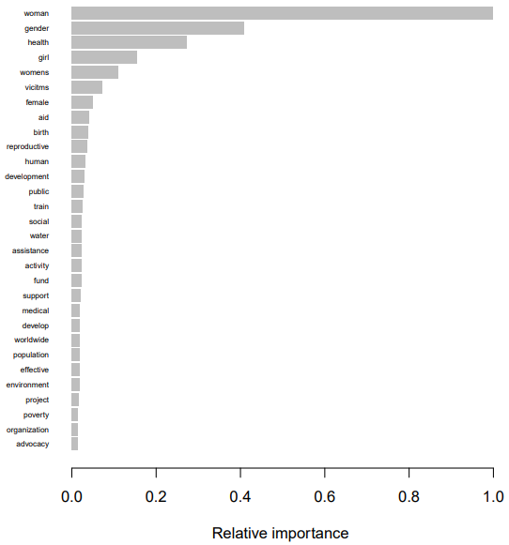
3.1 Text detection
Relative importance of words gives insight how probabilities are assigned
Good correspondence with how human would assign would assign weights

Slide 8
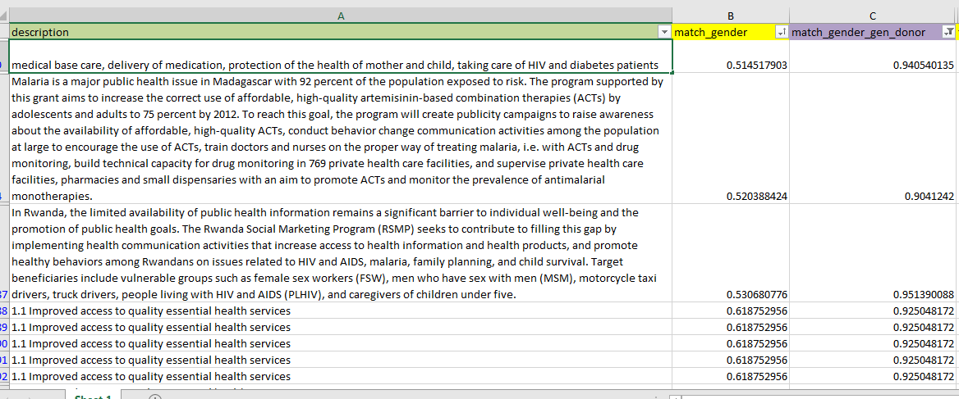
3.2 Channel code (gen donor)
Slightly higher focus on health by including the channel code
Possible reason: UN Women has slight bias towards gender health projects

Slide 9
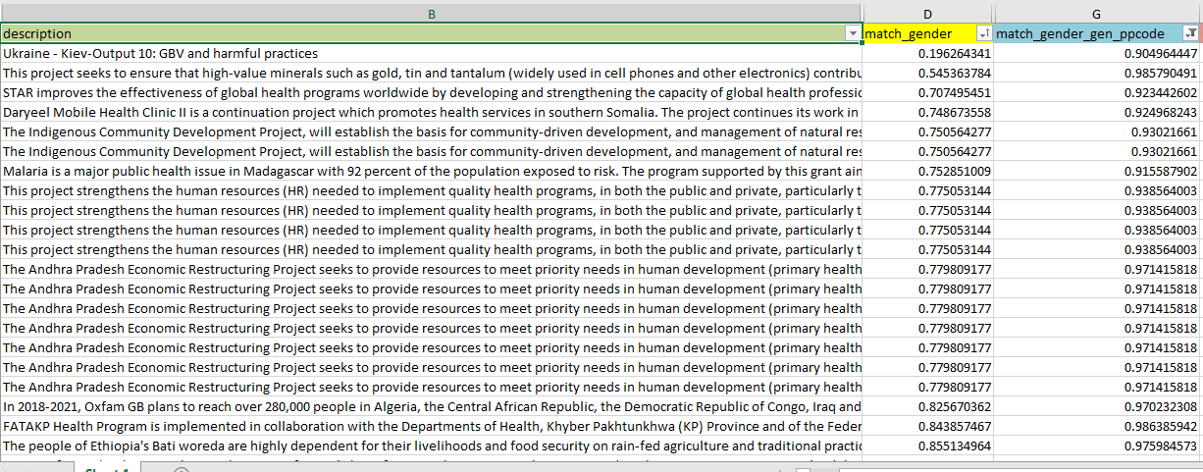
3.3 Text detection or purpose codes
Overall not many discrepancies (12 columns below belong to same projects)

Slide 10
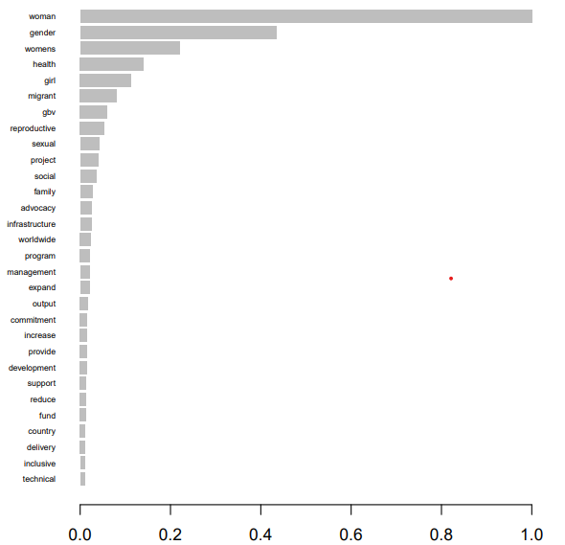
3.3 Text detection or purpose codes
Weight attached to right words
difference to solemn text detection: GBV only with purpose codes

Slide 11
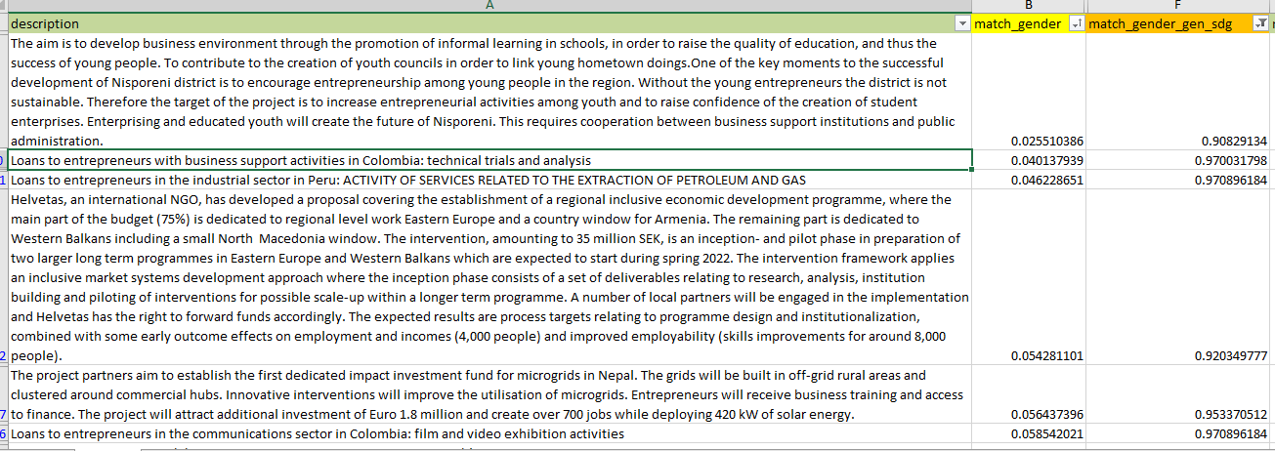
3.4 Text detection or SDG 5
SDG 5 introduces slight focus on economic activities (see also relative importance next slide)
Possible reason: overrepresentation of SDG 5.a + b. (Equal rights to economic resources, empowerment through technology) in CRS reporting/funding

Slide 12
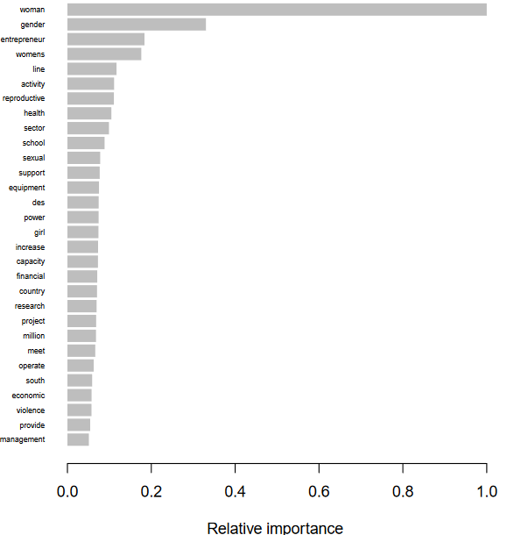
3.4 Text detection or SDG 5
Entrepreneur, activity, sector, equipment have fairly high importance

Slide 13
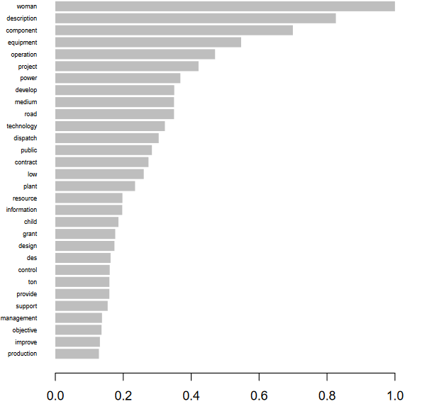
3.5 Text detection and gender marker
Gender marker too generic
Encompasses a wide range of projects so that generic word have high importance
Description, component, equipment, operation,…

Slide 14
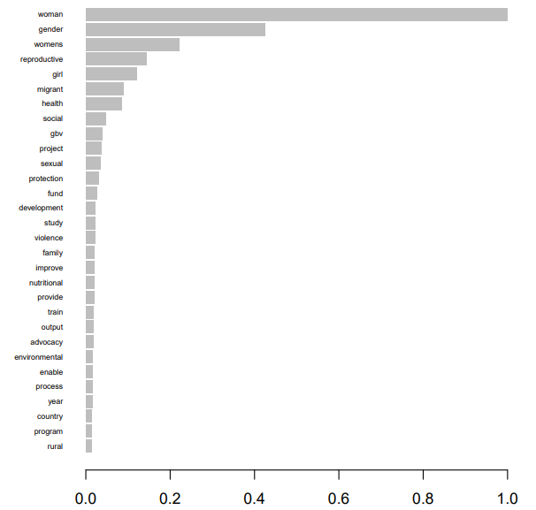
3.6 Text detection or channel code or purpose code
Generally: text detection, channel code and purpose code are reliable markers
→ union reflects importance of each
See union of all markers for further insight

Slide 15
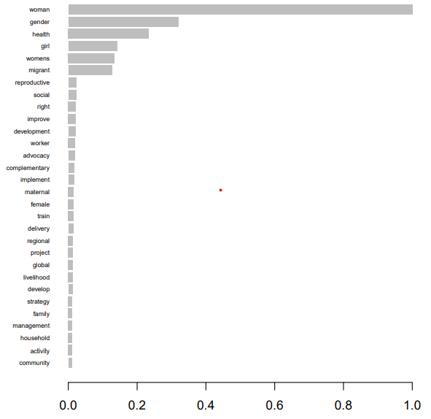
3.7 Text detection or intersection of rest
Text detection or (channel code and purpose codes and gen marker and sdg 5)
Cut off after infrequent words

Slide 16
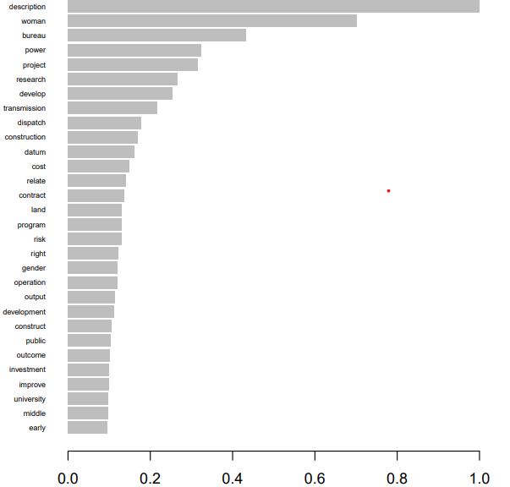
3.8 Union of all markers
Text detection or channel code or purpose codes or gen marker or sdg 5
Driven by too broad gen_marker → too much weight to generic words

Slide 17
4. Precautions
Unlucky draw: A sample of 1/50 of the full CRS data was used, so biases possible by chance (but very unlikely due to large learning set sizes n = 1105 – 1998)

Slide 18
5. Proposal
To avoid introducing unwanted biases towards health- or economic-related projects, we could use the text detection or purpose code
→ addition of purpose code adds some valuable information to the already good results from using only text detection
Pro
indirectly controllable through keyword list
Some markers (gen marker, SDG, …) may be unreliable
Assigns weight almost exclusively to gender-related terms
Only used for learning the text pattern, projects marked with other markers can still be included in final set of gender projects
Learning set easily large enough only with text detection and purpose code
Con
May be too narrow, so that certain frequent keywords are not accounted for
Would exclude additional focus on (gender) health projects from channel code

Slide 19
5. Proposal
Check for yourself:
folder with all results, pred_all.xslx for extensive results

